Slide 1

Bank Customer Churn Analysis
- Deepika A

Slide 2

Problem Statement:
Customer churn is one of the biggest challenges faced by banks today. High churn rates lead to lost revenue and also reduces the bank's customer base, making it harder to retain loyal clients.
Significance in the Banking Domain:
Churn can indicate dissatisfaction or unmet customer needs, which, if not addressed, can affect a bank’s profitability.
Impact on Business:
Reduced customer base .
Increased marketing and acquisition costs.
Difficulty in maintaining a steady revenue stream.
Goal:
Identify the factors leading to churn to develop strategies for retention and reduce customer attrition.

Slide 3


What is Customer Churn?
Customer Churn refers to the loss of clients or customers over a specific period. It's essential for banks to measure this metric to understand their rates and identify areas for improvement.

Slide 4

Key Factors Influencing Churn
Several factors contribute to customer churn, such as poor customer service, high fees, and lack of product oﬀerings. Identifying these factors is crucial for developing eﬀective retention strategies.

Slide 5
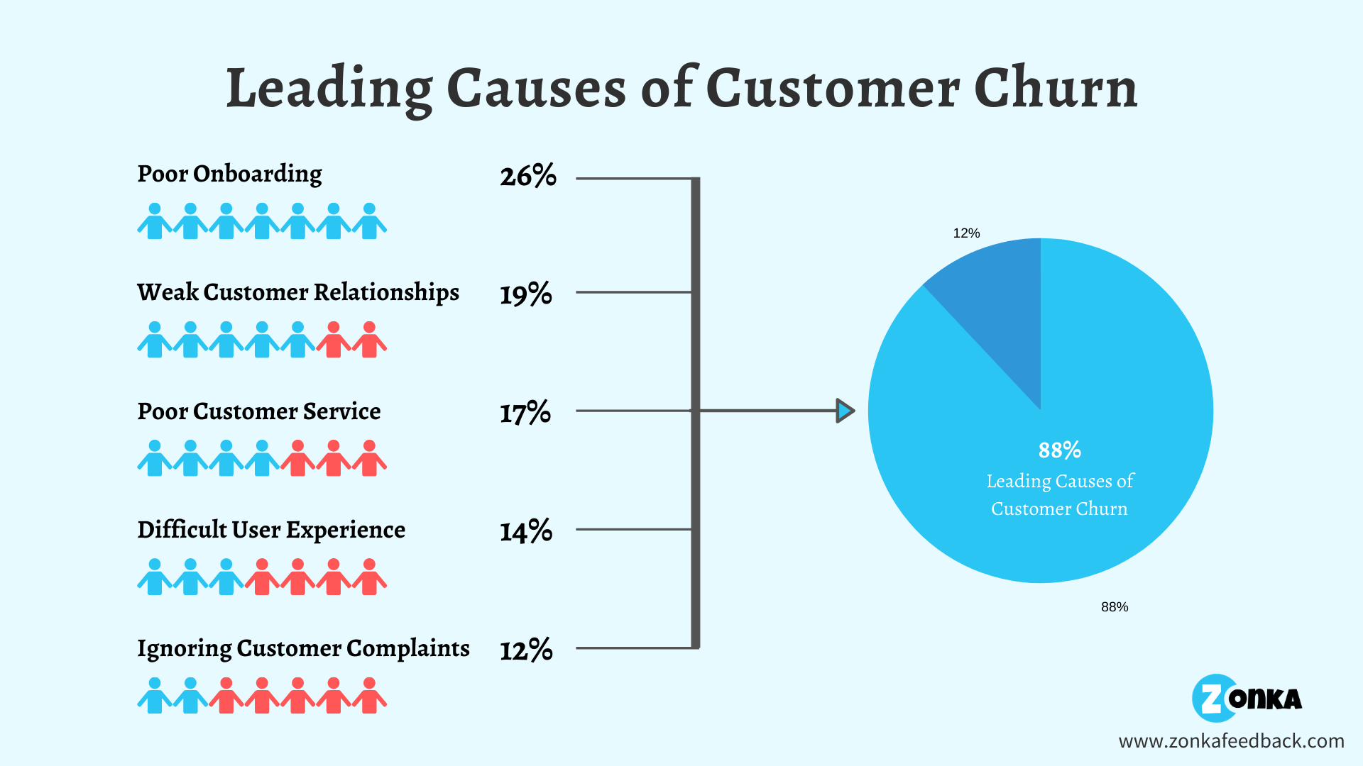

Slide 6

Strategies to Reduce Churn:
Implementing targeted strategies based on churn analysis can significantly reduce attrition rates. These strategies may include personalised manager, improved customer service, and loyalty programs.

Slide 7

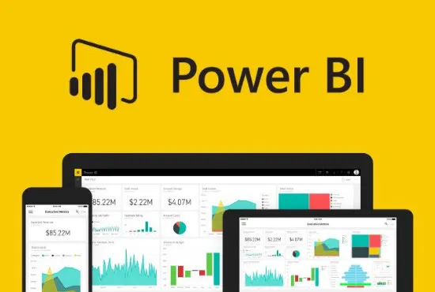
Role of Power BI
Power bI is a powerful tool for visualizing data and gaining insights into customer behavior. It enables banks to create interactive dashboards that highlight trends and patterns related to customer churn.

Slide 8

Proposed Solution:
To address the issue of customer churn, an interactive Power BI dashboard was developed to provide in-depth analysis of churn patterns using historical customer data.
How It Addresses the Problem:
The dashboard focuses on understanding key factors contributing to churn, such as customer demographics, account tenure, and product usage.
It allows stakeholders to identify customers at high risk of churn and take targeted actions to improve retention.

Slide 9

Phases Involved in Customer Churn Analysis:
Collect and Prepare Data: Gather, clean, and preprocess customer data.
Analyze Data: Use statistical methods to uncover patterns and correlations.
Develop Dashboard: Build an interactive Power BI dashboard with KPIs and visuals.
Generate Insights: Identify churn rates and high-risk customer segments.
Test and Refine: Validate accuracy and optimize user experience.

Slide 10

Implemention:
1.Collect and Prepare Data
Step 1: Collect Data
Ensure data includes key features like customer demographics, account tenure, product usage, and transaction history.
Gather customer data from various sources such as CRM systems, transaction records, and customer feedback surveys.
Step 2: Prepare Data
Clean the dataset by removing duplicates, filling missing values, and handling outliers.
Standardize data formats and preprocess the dataset using Power BI’s Power Query for efficient analysis.

Slide 11

2.Analyze Data
Step 3: Perform Statistical Analysis
Use statistical methods like correlation analysis and descriptive statistics to uncover patterns and trends.
Identify key factors contributing to churn, such as short tenure or low product usage.
Step 4: Segment Customers
Categorize customers based on attributes like age group, account type, and region to identify high-risk segments.
Create churn probability scores to prioritize customer retention efforts.

Slide 12

3. Develop Dashboard
Step 5: Design Visualizations
Add filters to Build interactive visualizations like bar charts, line graphs, and heatmaps to present churn trends clearly.
Include KPIs such as churn rate, average tenure, and customer lifetime value
Step 6: Implement Filters and Slicers
Allow users to analyze data by specific segments (e.g., region, age, product type).
Ensure the dashboard provides dynamic insights for actionable decisions.

Slide 13
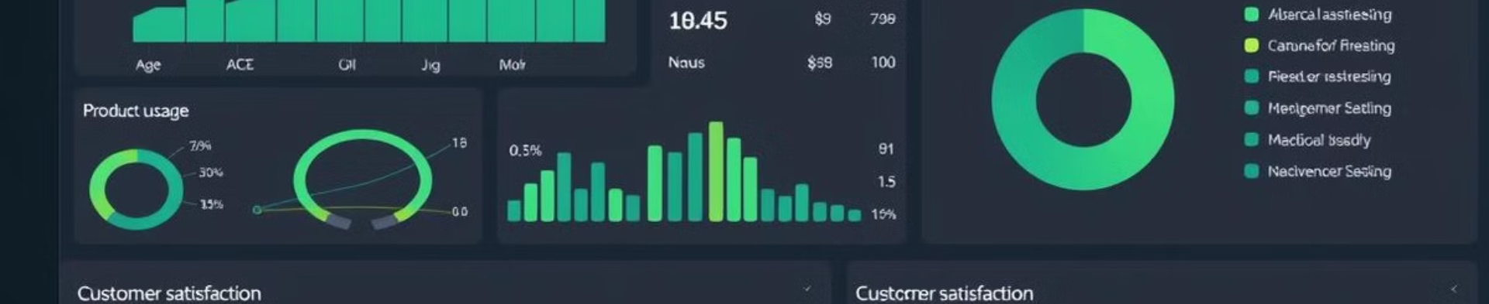
4: Generate Insights and Refine
Step 7: Identify Insights
Highlight trends such as regions with the highest churn or products that show low engagement.
Share actionable insights to help stakeholders target high-risk customers with retention strategies.
Step 8: Test and Refine
Validate the dashboard’s accuracy by comparing it against known churn cases.
Optimize user experience by refining visuals and improving performance.

Slide 14
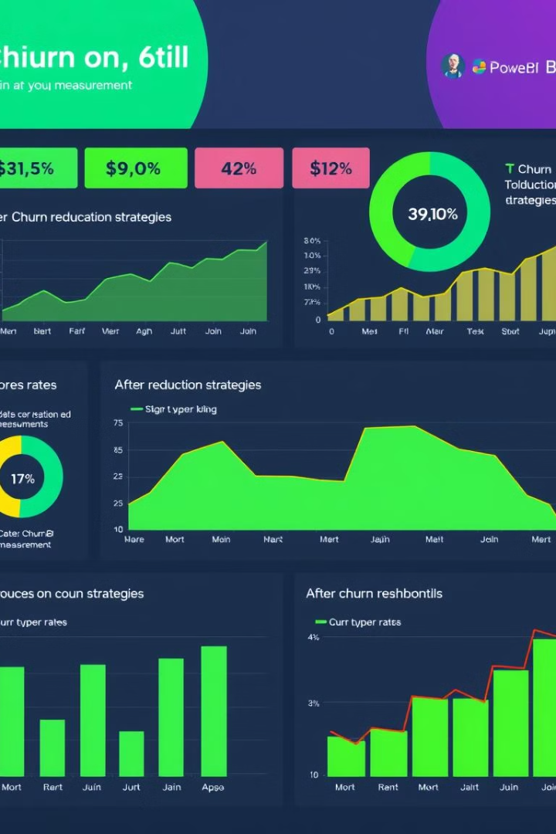
5: Deploy and Act
Step 9: Deploy the Dashboard
Share the finalized dashboard with stakeholders via Power BI service.
Train end-users on interpreting data and applying insights effectively.
Step 10: Implement Retention Strategies
Use the dashboard insights to execute retention campaigns such as personalized offers or loyalty programs.
Continuously monitor and update the dashboard with new data for ongoing improvement.

Slide 15
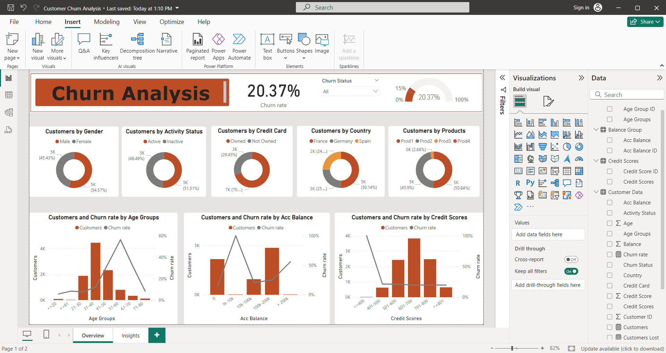
Customer churn Analysis Dashboard: Overview Page

Slide 16
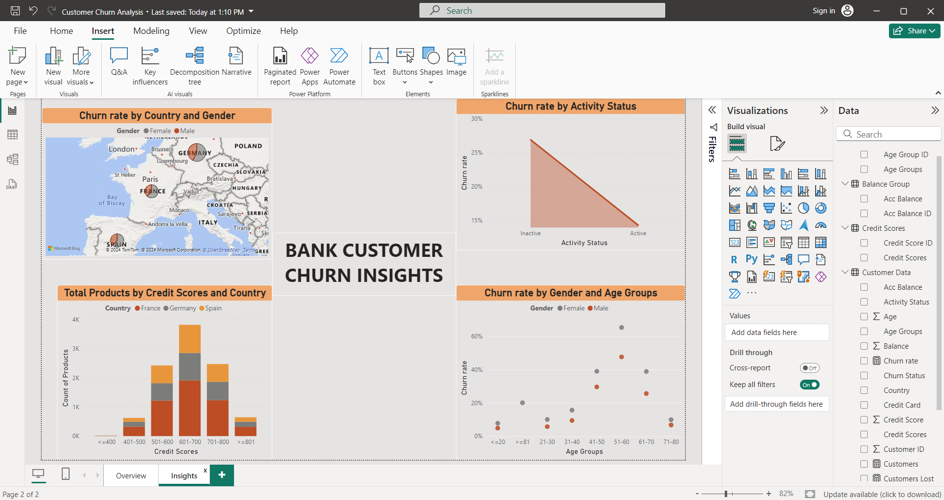
Customer churn Analysis Dashboard: Insights Page view

Slide 17

Challenges in Customer Churn Analysis:
1.Incomplete or Inconsistent Data
Missing values and duplicate entries affect data reliability.
2.Identifying Key Churn Drivers
Difficult to pinpoint the exact factors contributing to churn.
3.Handling Large Datasets
High data volume slows down processing and visualization.
4.Interpreting Insights Effectively
Complex insights may be hard for stakeholders to understand.
5.Ensuring Dashboard Adoption
Resistance to adopting new tools and processes among users.

Slide 18

Future Enhancements:
The future of churn analysis will likely involve advanced technologies like machine learning and AI. These innovations will enhance predictive capabilities, allowing banks to better understand customer behavior and improve retention strategies.

Slide 19
Conclusion:
Understanding customer churn is vital for banks aiming to improve retention.
Utilizing tools like Power bI enables data- driven insights, helping to identify churn
factors and implement effective strategies. Continuous analysis is key to maintaining
a loyal customer base.

Slide 20



